Slide 1
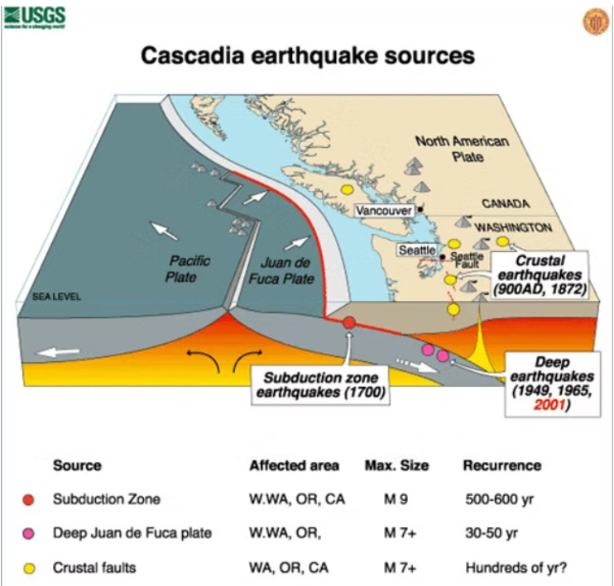

Capstone Project
Seattle, WA
Earthquake Depth Prediction ML Model
Earthquake Depth Prediction
Using Machine Learning
Kevin McKinney
Click on the model to interact

Slide 2
Problem Statement
Earthquake depth directly affects surface damage, tsunami risk, and corresponding emergency response teams that will be deployed to help treat the injured and save lives.
Learning objectives
Build a predictive model using geophysical features to estimate earthquake depth
Regression models will be used because they can quantify and model the relationship between variables. In addition, they are good analyzing historical data, they can learn patterns and use this knowledge to predict outcomes for new data.
Keywords

Slide 3
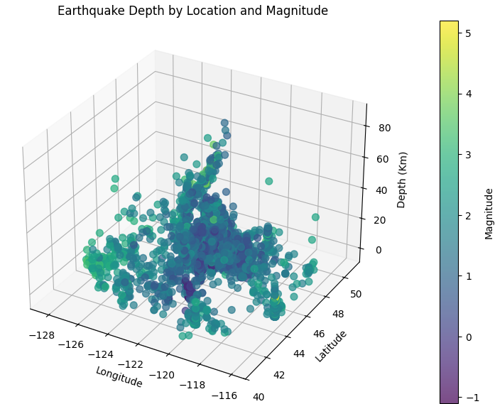
1. Data Overview PNSN.org
Features will be
Magnitude
Latitude
Longitude
Hour
Day
Month
Year
Target: Depth of point of rupture (in kilometers)
Preprocessing:
Handle Missing values/data.
Feature scaling (StandardScaler).
Polynomial Expansion (PolynomialFeatures).

Slide 4
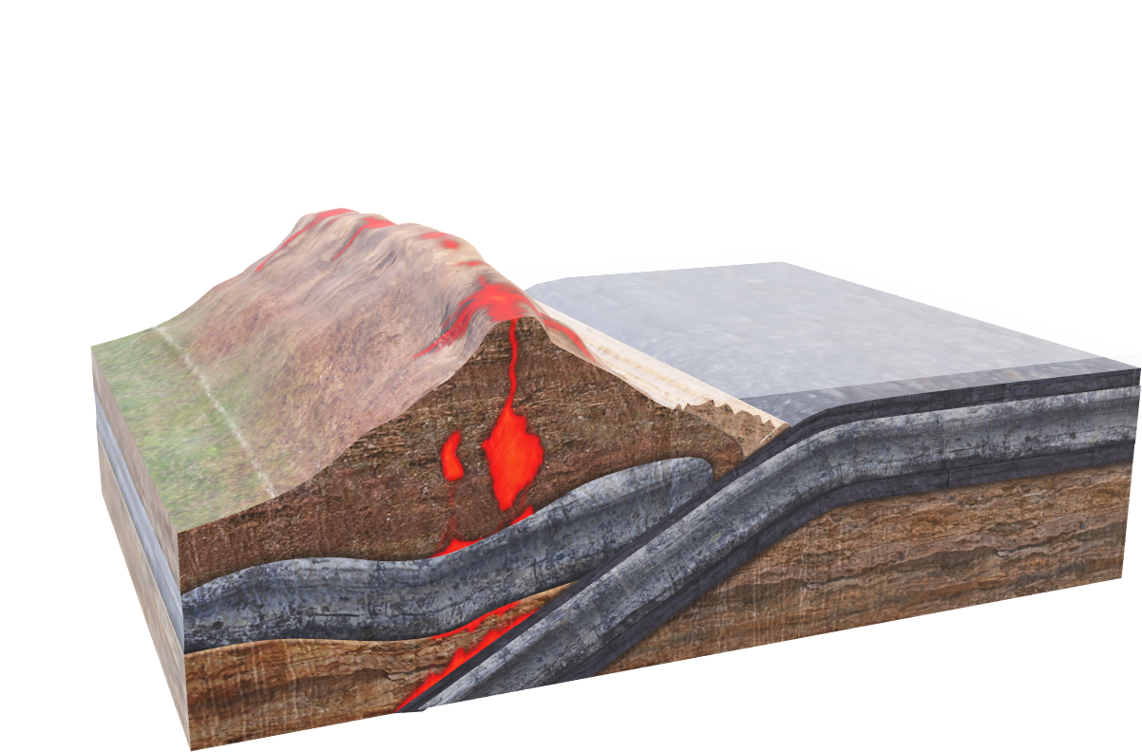
2. Model Selection
Linear Regression
Assumes a linear relationship between input features and earthquake depth
Coefficients show how each feature will influence depth
Fast to train and easy to deploy
Polynomial feature expansion to capture nonlinear patterns
Random Forest Regressor
Can capture nonlinear relationships and feature interactions
Provides a feature importance score
Robust to noise
Hyperparameter tuning improves performance

Slide 5
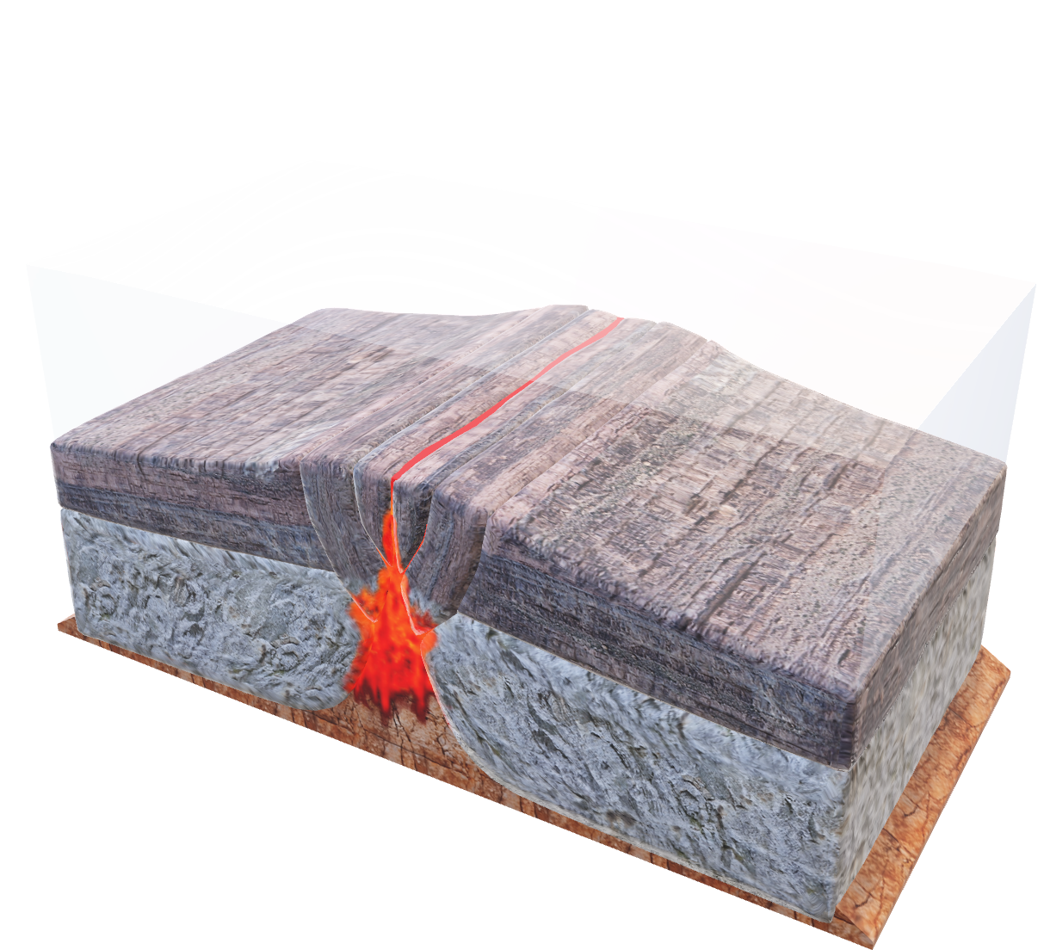
2. Model Selection
Gradient Boosting Regressor
Builds trees based on the results of the previous one
Excels at modeling complex, nonlinear patterns in earthquake data
Can achieve higher accuracy then Random Forest on clean, well-preprocessed datasets
Can use cross-validation and early stopping to prevent overfitting, producing a more trusted model

Slide 6
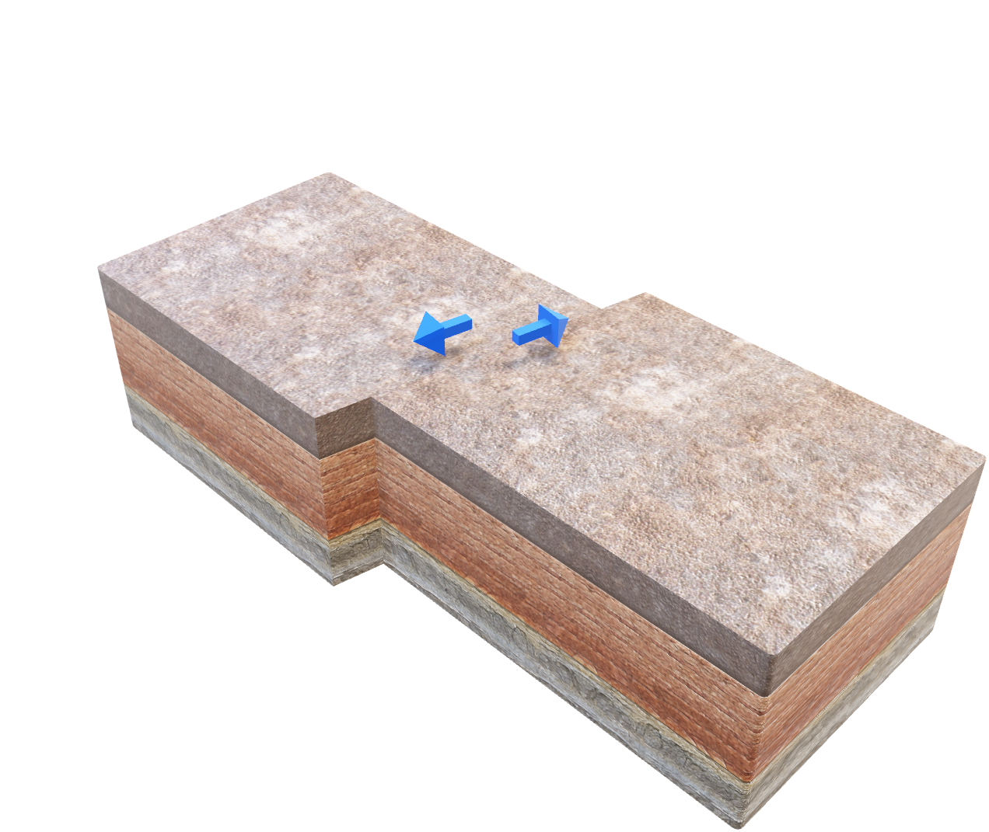
3. Compare Models
Linear RMSE: 8.14
Linear R² Score: 0.2451539653561956
Random Forest RMSE: 5.67
Random Forest R² Score: 0.6342632358549829
Gradient Boosting RMSE: 6.18
Gradient Boosting R² Score: 0.5653432004174112
Based on the above metrics:
Linear Regression – Is a weak fit and captures only 24.5% of depth variance
Random Forest – Strong fit and captures 63.4% of variance with lower error
Gradient Boosting – Moderate Fit and better than Linear but behind Random Forest

Slide 7
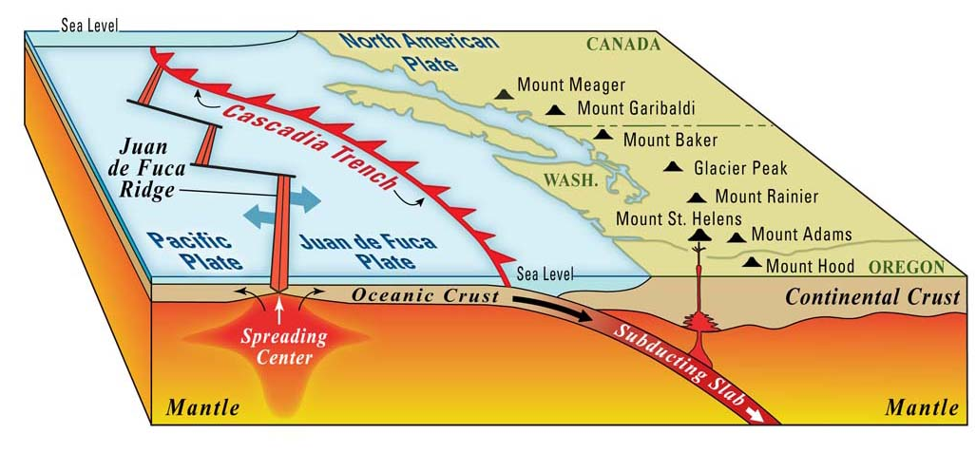
3. Polynomial Regression Model
Polynomial Regression Model have the best RMSE and R2 score of:
RMSE: 7.88
R² Score: 0.29
Meaning it has a better model to predict earthquake depth based on the data proveded.

Slide 8
4. Reference
https://www.seattleretrofit.com/post/what-you-should-know-about-fault-lines-around-seattle
https://www.historylink.org/File/5098
https://www.usgs.gov/centers/earthquake-science-center/seattle-field-office

